Slide 1
Deploy Virtual Machine

Slide 2
All configuration options and settings visible in this presentation can be different than yours. It depends on your privileges, settings and agreement.

Slide 3
Log in to VM Cloud Services

Slide 4
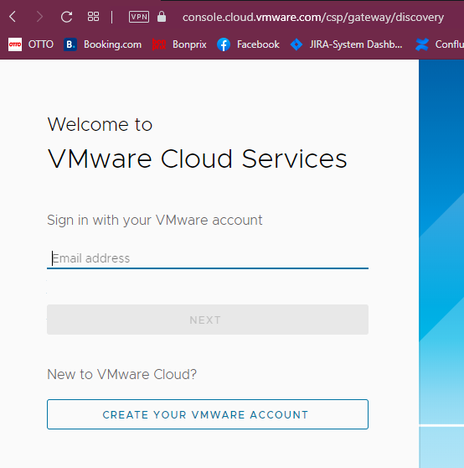
Enter the email address previously added to VMware Cloud Services

Slide 5
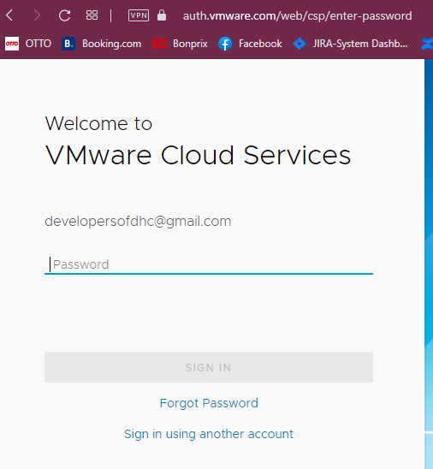
Enter the password for your account

Slide 6
Deploy machine using Service Broker

Slide 7
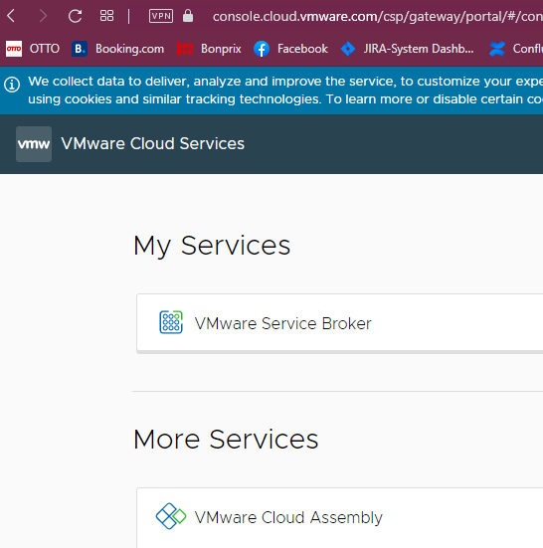
In Section “My Services” find a block with the title “Vmware Service Broker” – click on it.
Notice:
look of this page is up to your privileges and roles which are assigned to your account

Slide 8
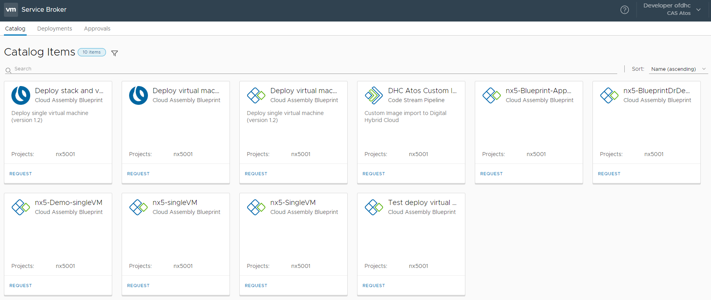
Example view – the number of items depends on permissions and roles

Slide 9
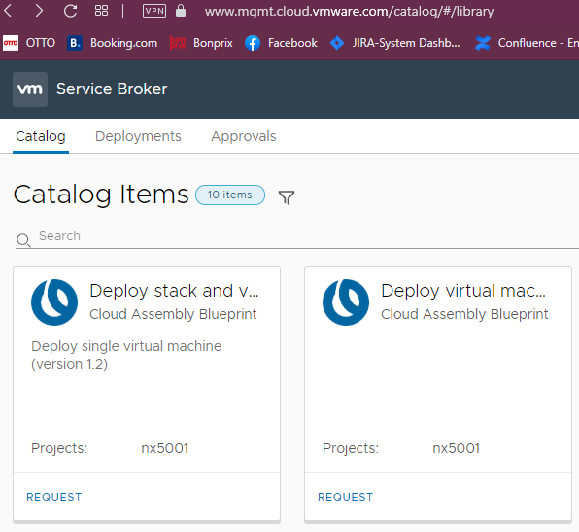
Find the item which allows you to deploy single virtual machine

Slide 10
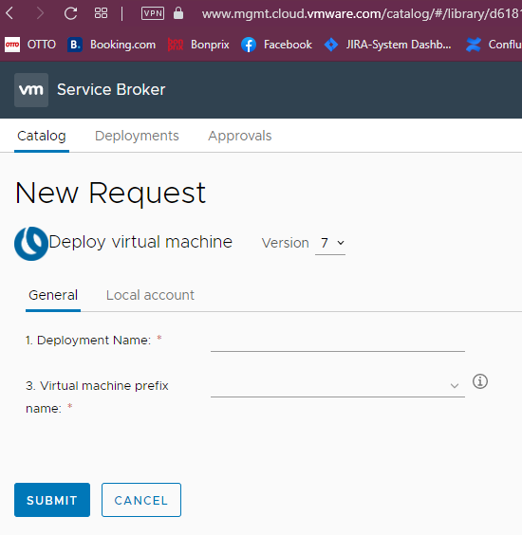
In tab General you will provide necessary data which allow you to deploy machine.
Enter the deployment name
Notice:
this name will be visible in “Deployments” section. The name allows you to identify your VM.

Slide 11
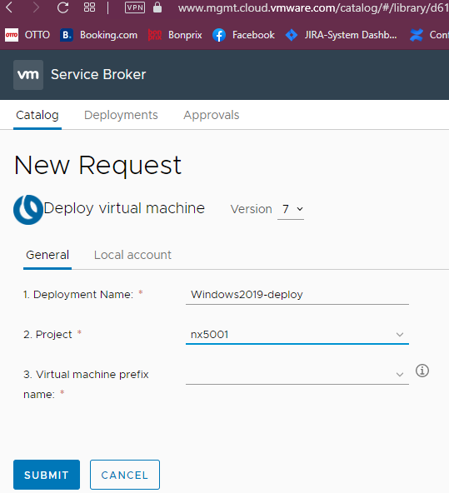
In tab General you will provide necessary data which allow you to deploy machine.
Choose the Project
Notice:
From default, project will be chosen if your account is assigned to one project. If you have privileges to more than one project, the first project from the top will be chosen.

Slide 12
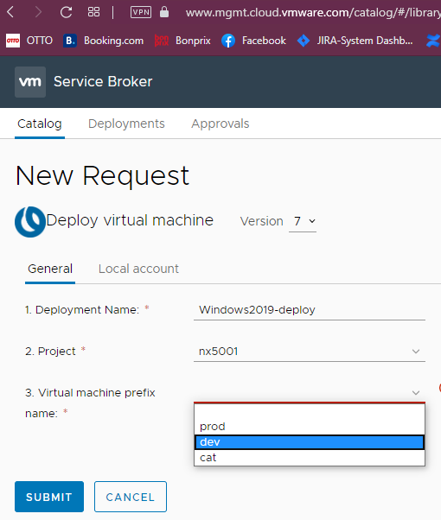
In tab General you will provide necessary data which allow you to deploy machine.
Choose machine prefix
Notice:
Machine prefix is a part of the whole name of machine. The numbers of the position to choose depend on project setting.

Slide 13
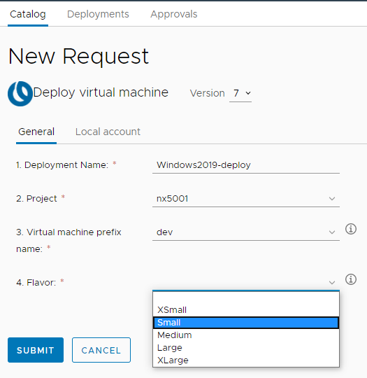
In tab General you will provide necessary data which allow you to deploy machine.
Choose Flavor
Notice:
Flavor describes which resources will be assigned to the machine.
Example:
XSmall will be assigned to machine 1vCPU and 2048MB memory

Slide 14
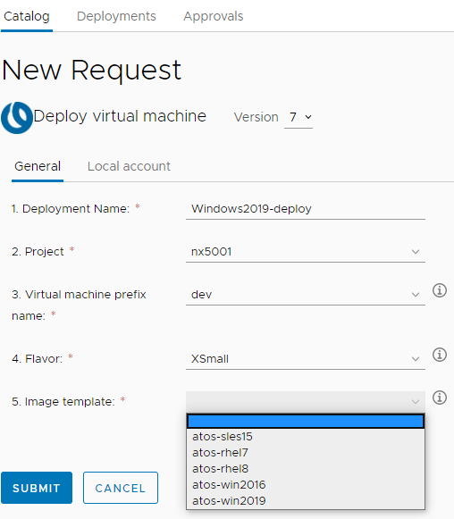
In tab General you will provide necessary data which allow you to deploy machine.
Choose Image template
Notice:
This section contains information about available templates and operating systems which you can deploy

Slide 15
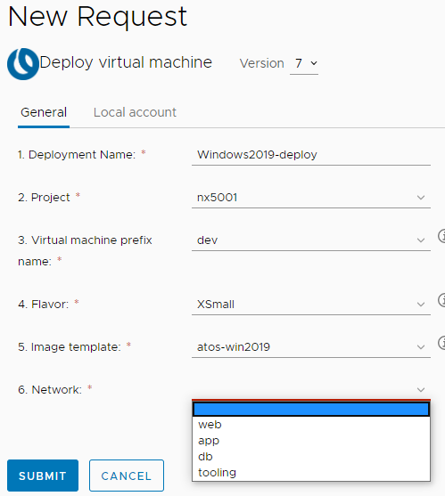
In tab General you will provide necessary data which allow you to deploy machine.
Choose Network
Notice:
In this section you can choose a specific kind of network which will be connected to your virtual machine.

Slide 16
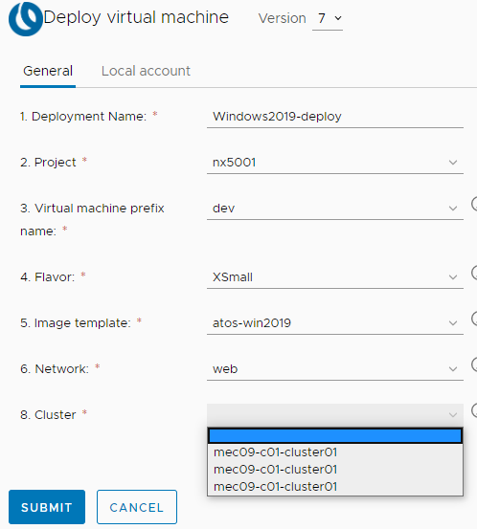
In tab General you will provide necessary data which allow you to deploy machine.
Choose Cluster
Notice:
This section allow you to choose the vCenter which will store your VM.

Slide 17
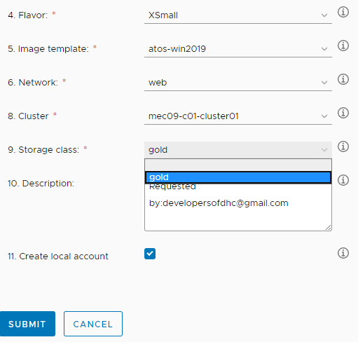
In tab General you will provide necessary data which allow you to deploy machine.
Choose Storage class
Notice:
This section allows you to choose what kind of storage can be used to store your machine.
Example:
Gold – all VM will be stored on a flash disk

Slide 18
In tab General you will provide necessary data which allow you to deploy machine.
Checked Create local account
Notice:
This checkbox from default is checked. It allows you to create a local user and define a password for them

Slide 19
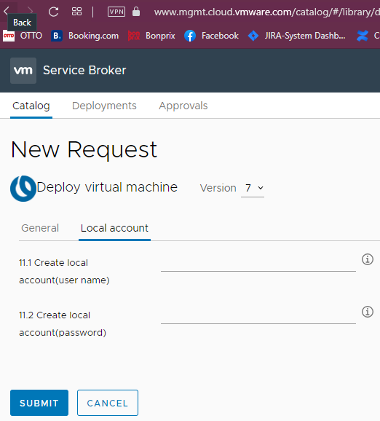
In tab General you will provide necessary data which allow you to deploy machine.
Create the local account and define the password for the account
Notice:
From this place you can define only one local user.
If you provide all necessary data and you are sure they are correct click SUBMIT

Slide 20
Deployment

Slide 21
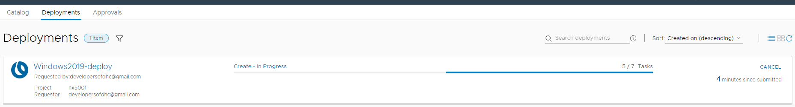
Deployment Name
Deployment Description
Status of deployment
Project name
Requestor

Slide 22
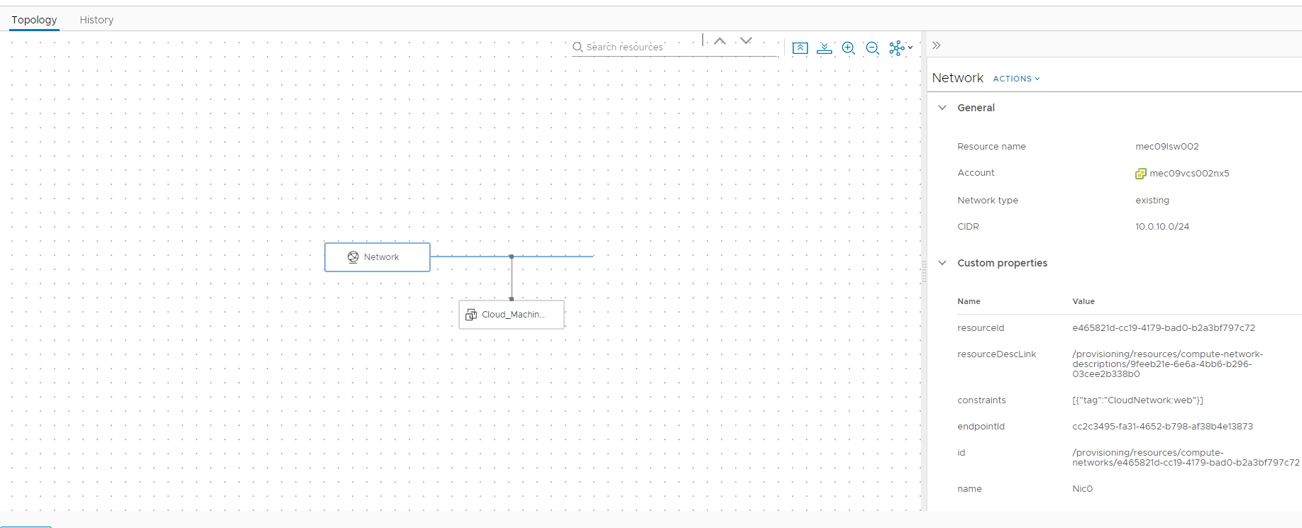
Settings summary
Topology of VM

Slide 23
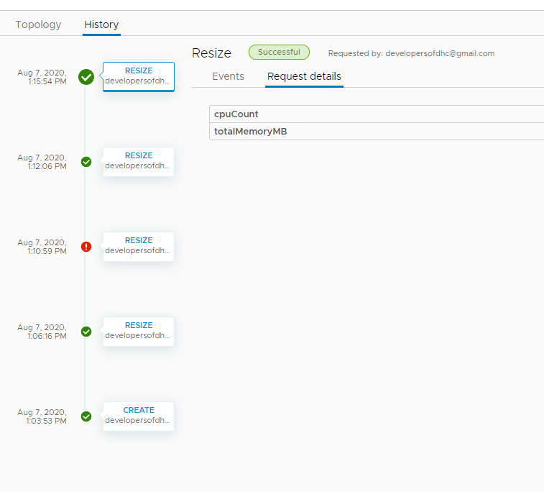
Virtual machine change history
Request details - summary
History contains information about failed and success

Slide 24
Thank you For more information please contact: T+ 33 1 98765432 M+ 33 6 44445678 firstname.lastname@atos.net

